Slide 1

Hotel Booking Analysis
Understanding customer behavior and revenue trends to drive profitability.

Slide 2

Project Overview
Analyze Data
Identify Drivers
Understand booking behavior, cancellation patterns, and revenue trends.
Pinpoint factors influencing bookings and cancellations.
Recommendations
Provide actionable insights to boost profitability and retention.

Slide 3
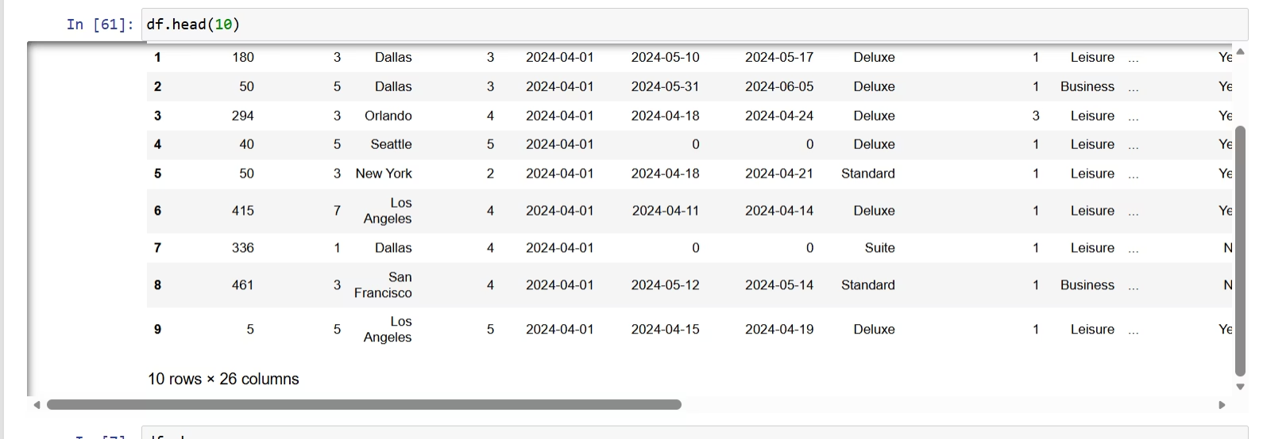
Dataset Summary
Overview
Rows: 30,000
Columns: 26
Key Features
Booking details (dates)
Customer & property info
Booking behavior (channel, stay type)
Financials (value, markup)
Cancellation info (status, refund)

Slide 4
Exploratory Data Analysis (EDA)
Using Python (Pandas, Matplotlib, Seaborn) for data cleaning and analysis.
01
02
03
Data Loading
Initial Exploration
Data Cleaning
Imported dataset with pandas.
Used df.info() and df.describe().
Removed special characters, handled missing values.
04
05
Feature Engineering
Cancellation Analysis
Extracted booking month, analyzed length of stay.
Compared cancelled vs. confirmed bookings, refund behavior.

Slide 5
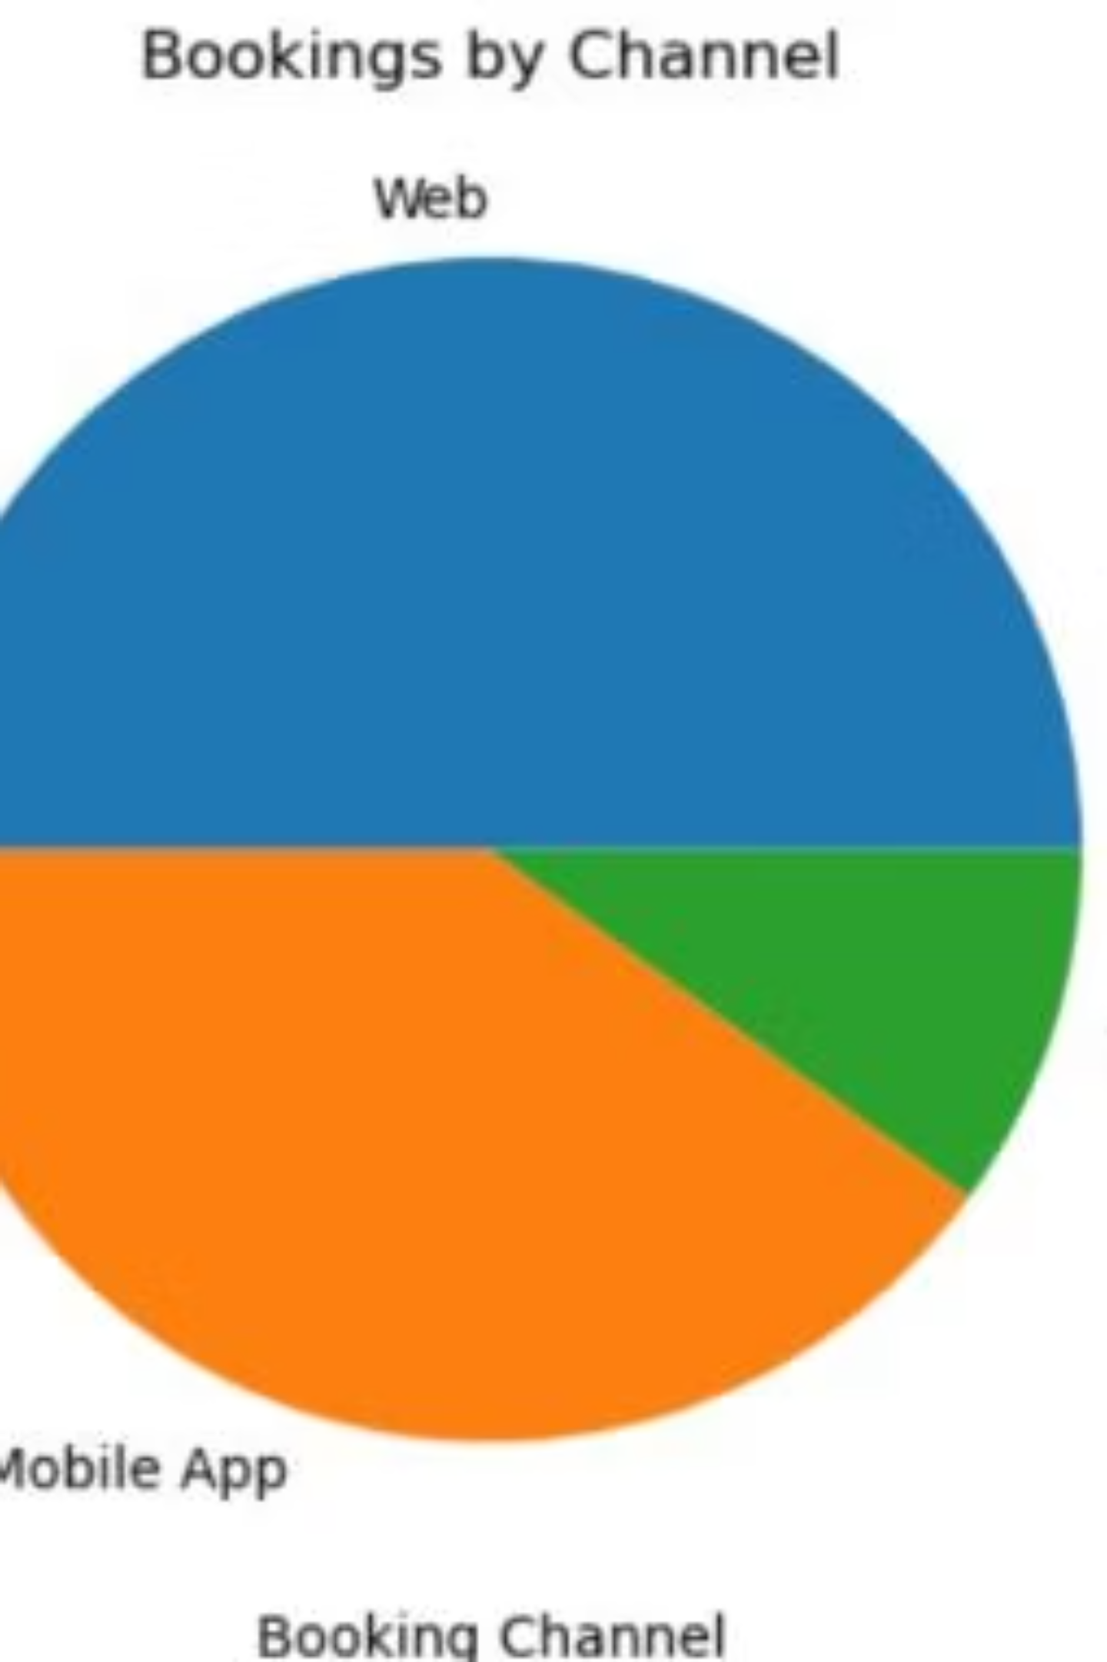
Bookings by Channel
Web channel dominates bookings, followed by Mobile App and Travel Agent.
The Web channel accounts for the largest portion of bookings, indicating its importance.

Slide 6
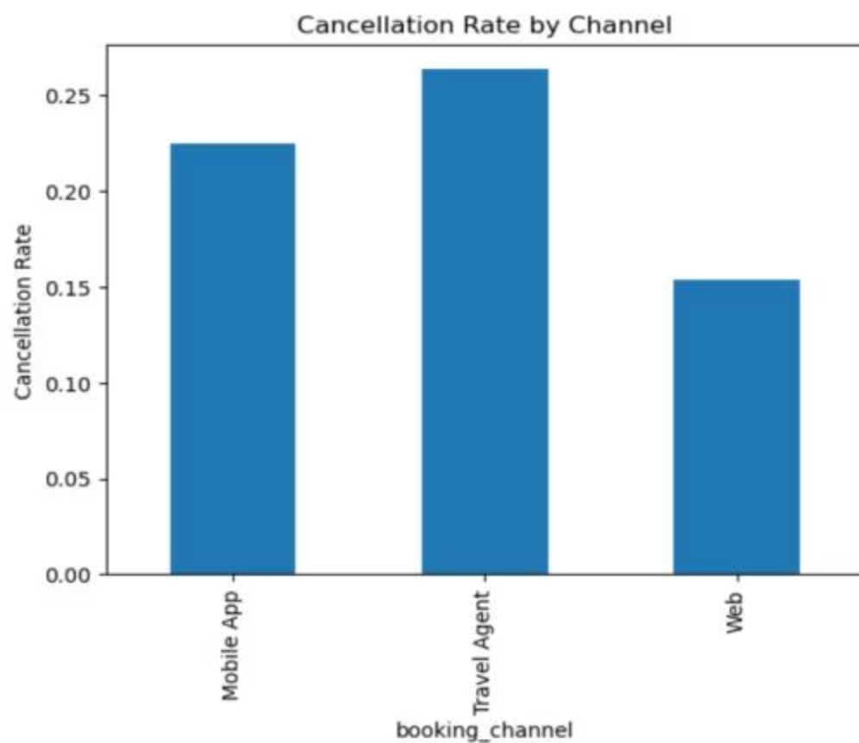
Cancellation Rates
Travel Agents show the highest cancellation rate, while Web bookings have the lowest.
Mobile App
0.22
Travel Agent
0.25
Web
0.15
Travel Agent bookings have the highest cancellation rate at 25%.

Slide 7
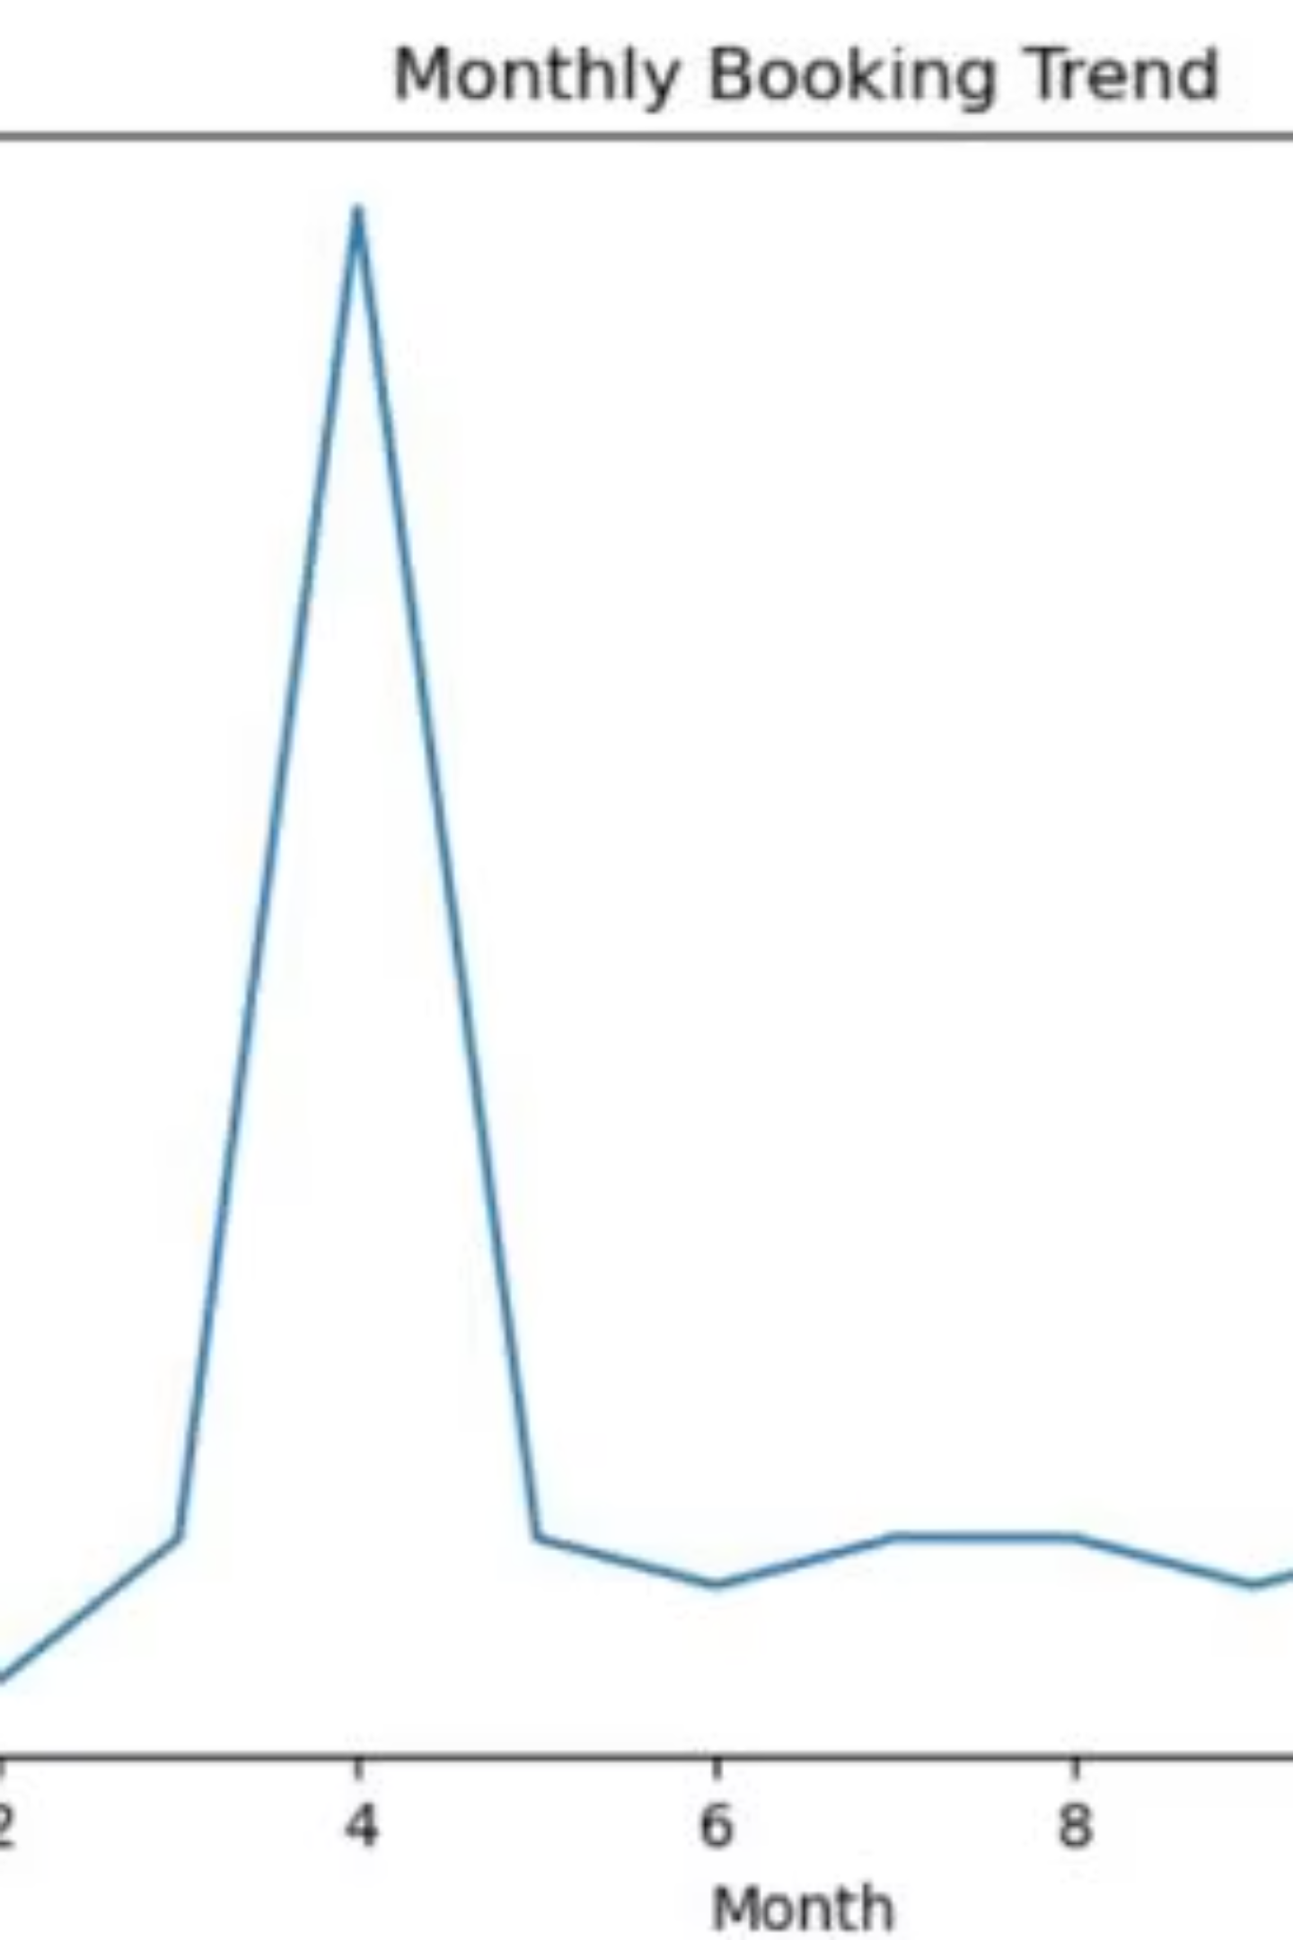
Monthly Booking Trend
Bookings peak significantly in Month 4, then stabilize.
This trend suggests seasonal influences on booking volumes.

Slide 8

Key Observations & Insights
Booking Trends
Online channels lead bookings.
Standard rooms are most popular.
3-star and 4-star hotels receive maximum bookings.
Cancellation Behavior
Online bookings have higher cancellation rates.
Premium rooms show lower cancellations.
Refundable bookings increase cancellation probability.
Time-Based Patterns
Bookings peak during holidays.
Longer stays common on weekends.

Slide 9

Business Recommendations
1
2
Reduce Cancellations
Improve Profitability
Introduce partial refunds.
Upsell Premium rooms.
Offer non-refundable discounts.
Offer loyalty benefits.
Focus on 4-5 star hotels.
Send check-in reminders.
3
Optimize Strategy
Exclusive direct booking deals.
Reduce high-commission channel dependency.
Dynamic pricing for peak seasons.

Slide 10

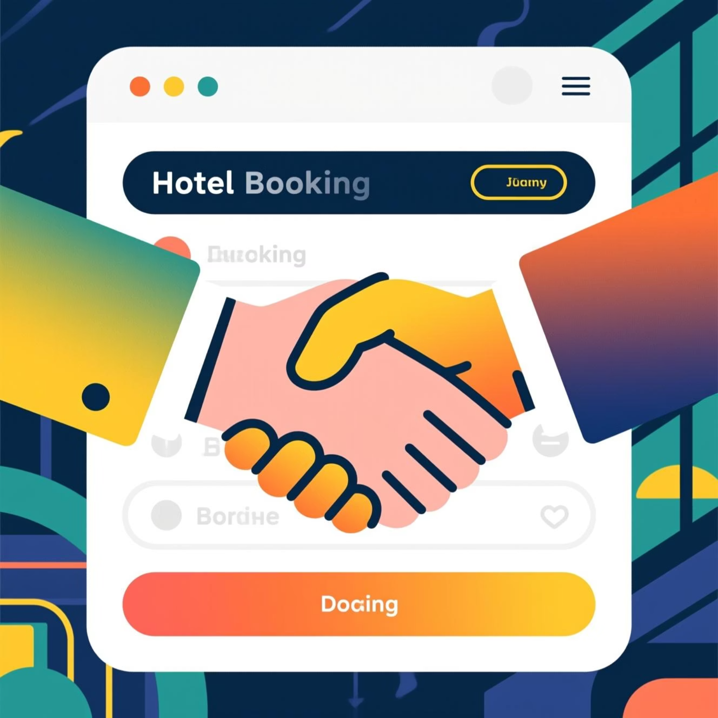
Conclusion & Tools Used
This analysis offers clear insights into booking behavior, cancellation drivers, and revenue opportunities.
Key Takeaways
Tools Utilized
By optimizing pricing, channels, and reducing cancellations, hotels can significantly improve revenue and customer loyalty.
Python
Pandas, Matplotlib, Seaborn
PostgreSQL
Data analysis queries
Jupyter Notebook
Analysis execution

